Slide 1
Statistics in Data Science

Slide 2
Topics
p value
Hypothesis Testing
Confidence Interval
Significance Value
Type I and Type II errors
One tailed and two tailed test
Z-test, T-test, Chi-square test

Slide 3

p Value
Touching the mouse pad
For ex- every 100 times, I touch the mouse pad, 80 times I touch this region in the bell curve
What do you mean by 0.01?

Slide 4
CAN YOU CHECK WHETHER A COIN IS FAIR OR NOT?

Slide 5
Inferential Statistics : Hypothesis Testing
Null Hypothesis
Alternate Hypothesis
Experiment
Accept/Reject the Hypothesis

Slide 6
Test whether a coin is fair or not?
Lets perform 100 tosses (experiment)
Null Hypothesis (H0) : Coin is fair
Alternate Hypothesis (Hi) : Coin is unfair
Experiment
Accept/Reject the Null Hypothesis:

Slide 7
Hypothesis Testing & Confidence Interval
Let’s say I get 30 times Head out of the 100 times I tossed. What can we say about it? Fair/Unfair?

Slide 8
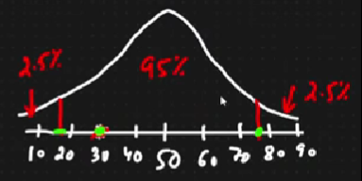
Hypothesis Testing & Confidence Interval
Lets say I get 30 times Head. What can we say about it? Fair/Unfair?
Here comes the concept of significance value i.e. how far from the mean it is acceptable. We need to define how far it is away from the mean?
alpha = 0.05
alpha is significance value
1-0.05 = 0.95 i.e. 95% confidence interval
(Defined by domain expert)

Slide 9
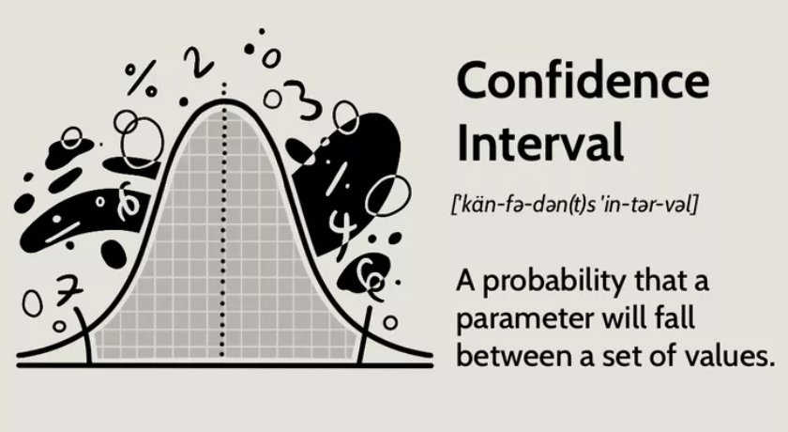
Confidence Interval

Slide 10
Confidence Interval (contd..)
For ex, I get 20 heads out of 100 experiments and the confidence interval is between 20% and 75%?
Should we accept the null hypothesis?
For ex, I get 20 heads out of 100 experiments and the confidence interval is 95%?
Should we accept the null hypothesis?

Slide 11
Confidence Interval (contd..)
If alpha = 0.3?
What is the confidence interval?
1-0.3 = 0.7 (70%)

Slide 12
Type I and Type II Errors
Null Hypothesis : Coin is fair
Alternate Hypothesis : Coin is unfair
Accept/Reject the Null Hypothesis:
Reject the null hypothesis: In reality it is False [Correct]
Reject the null hypothesis: In reality it is True [Wrong] TYPE I ERROR
Death Sentence : Person is given death sentence but he is innocent.

Slide 13
Type I and Type II Errors
Null Hypothesis : Coin is fair
Alternate Hypothesis : Coin is unfair
Accept/Reject the Null Hypothesis:
Reject the null hypothesis: In reality it is False [Correct]
Reject the null hypothesis: In reality it is True [Wrong] TYPE I ERROR
Accept the null hypothesis: In reality it is False [Wrong] TYPE II ERROR
Accept the null hypothesis: In reality it is True [Correct]
Death Sentence : Person is given death sentence but he is innocent.
Person has committed crime but is not declared innocent.

Slide 14
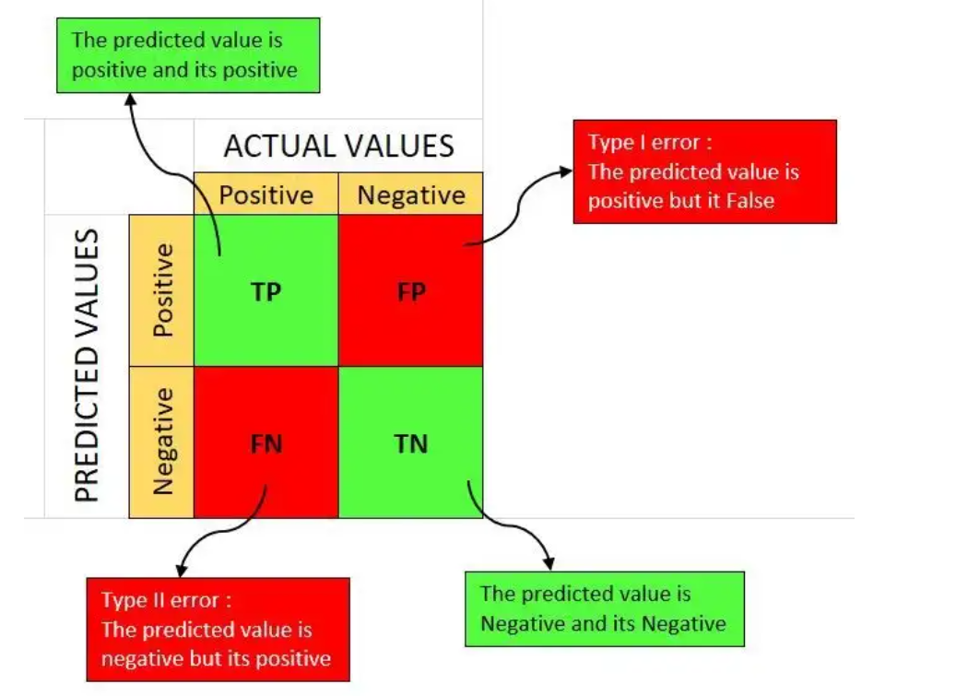
Type I and Type II Errors : Confusion Matrix

Slide 15
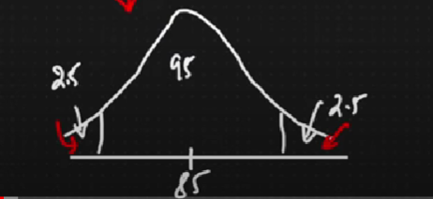
1 tail and 2 tail Test
A college in Karnataka has an 85% placement rate. A new college got recently opened and a sample of 150 students had a placement rate of 88% with a sd of 4%? Does this college have a different placement rate than the previous college? The significance value is 0.05.
Lets identify which test it is?

Slide 16
1 tail and 2 tail Test
A college in Karnataka has an 85% placement rate. A new college got recently opened and a sample of 150 students had a placement rate of 88% with a sd of 4%? Does this college have a different placement rate than the previous college? The significance value is 0.05.
Lets identify which test it is?
2 tailed test

Slide 17
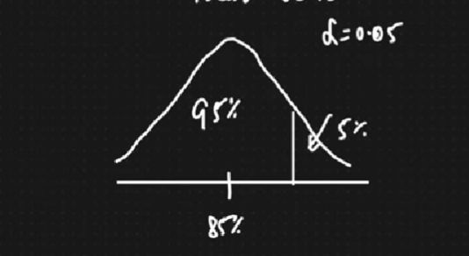
1 tail and 2 tail Test
A college in Karnataka has an 85% placement rate. A new college got recently opened and a sample of 150 students had a placement rate of 88% with a sd of 4%? Does this college have a greater placement rate than the previous college? The significance value is 0.05.
Lets identify which test it is?

Slide 18
1 tail and 2 tail Test
A college in Karnataka has an 85% placement rate. A new college got recently opened and a sample of 150 students had a placement rate of 88% with a sd of 4%? Does this college have a greater placement rate than the previous college? The significance value is 0.05.
Lets identify which test it is?
1 tailed test

Slide 19
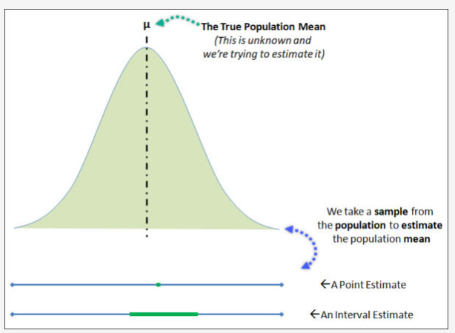
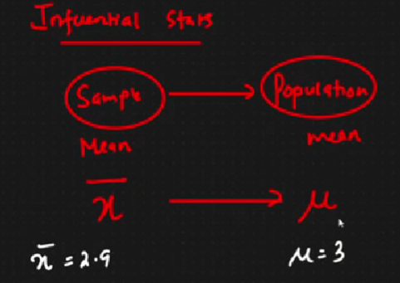
Calculation of confidence interval : Point estimate

Slide 20

Calculation of confidence interval : Point estimate
In the CAT Quant Test, the sd is known to be 100. A sample of 25 people has a mean of 520. Construct a 95% interval interval about the mean?
sd= 100, n =25, mean = 520, alpha =0.05

Slide 21
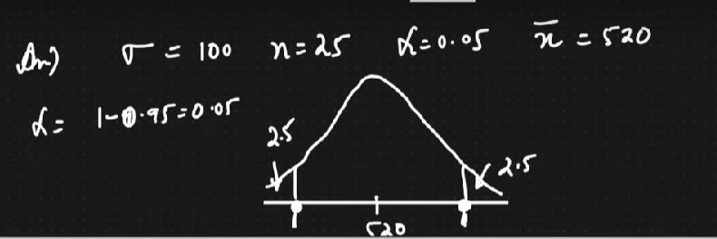
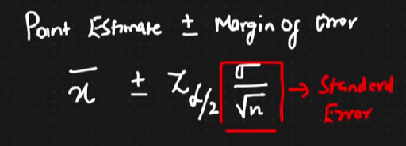
Calculation of confidence interval : Point estimate
kjfk
For Z score to be calculated, you important conditions need to be followed-
Population sd is given
Sample Size greater or equal to 30

Slide 22
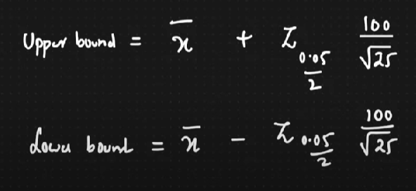
Calculation of confidence interval : Z score

Slide 23
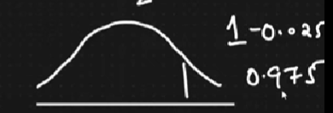
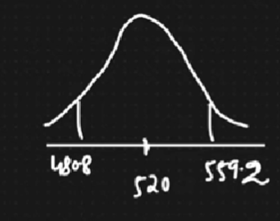
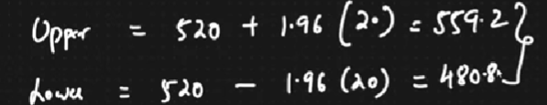
Calculate Z score for the problem statement
Z = 1.96

Slide 24
Interview Question: Find the average size of the sharks throughout the world

Slide 25
Interview Question:
In the CAT Quant Test, a sample of 25 people has a mean of 520. Construct a 95% interval interval about the mean?
n =25, mean = 520, alpha =0.05
When sd not given, T-test is used.

Slide 26
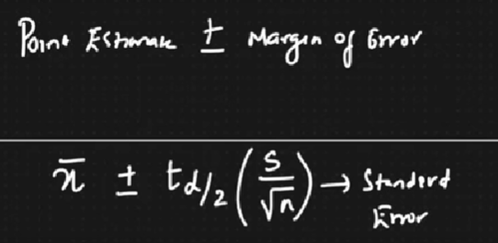
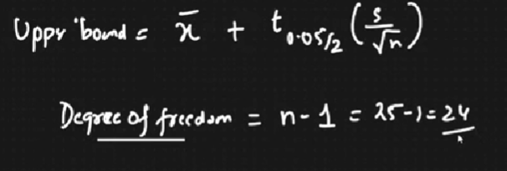
Calculation of CI

Slide 27
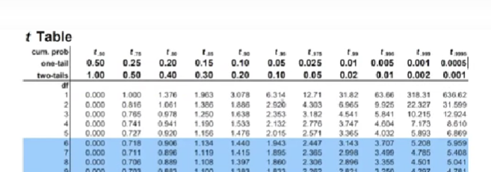
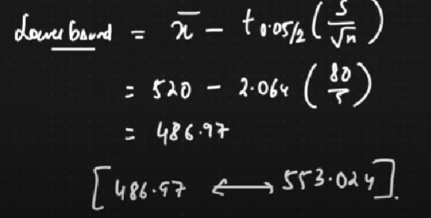
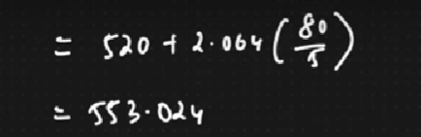
Finding CI after figuring out t value

Slide 28
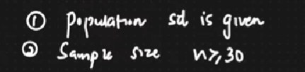
One sample Z test
In a population, average IQ=100 with a sd of 15. Researchers want to test a medication to see if there is positive or negative or no effect at all. A sample of 30 participants who have taken the medication has a mean IQ of 140. Did the medication affect the intelligence?

Slide 29
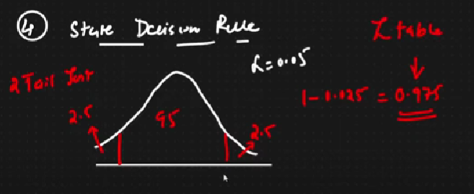
Interview Question: Hypothesis Testing
Define Null Hypothesis (The mean IQ is 100)
Mean=100
Define Alternate Hypothesis (The mean IQ is not equal to 100)
State alpha value (0.05)
State decision rule
The medication affected (increased or decreased) > 2 tailed test

Slide 30
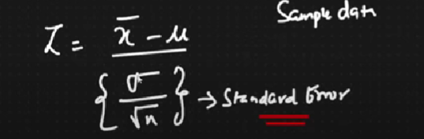
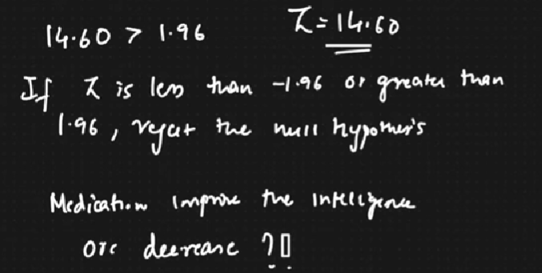
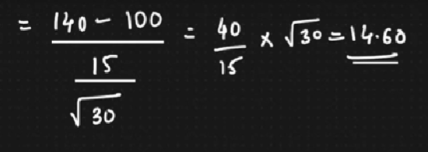
Interview Question: Hypothesis Testing
5. Calculate test statistics = Z test statistics

Slide 31

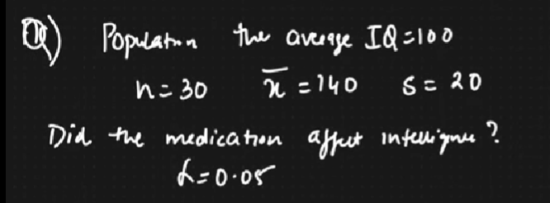
One sample t test

Slide 32
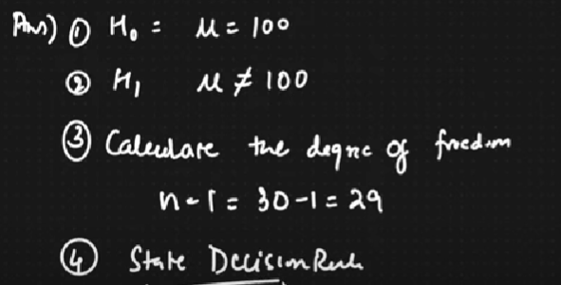
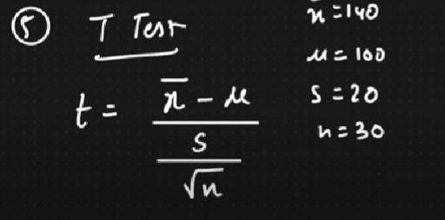
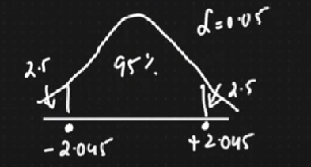
One sample t test: Solution
If the t value should be between this, if its more
or less than this, you reject the NULL HYPOTHESIS.

Slide 33
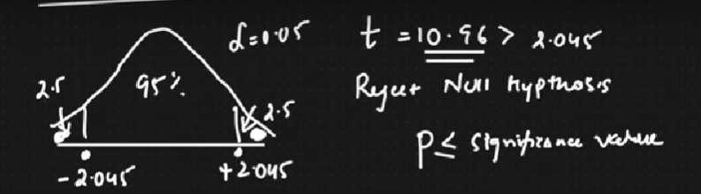
One sample t test: Solution
If the t value should be between this, if its more
or less than this, you reject the NULL HYPOTHESIS.
If the t value should be between this, if its more
or less than this, you reject the NULL HYPOTHESIS.
So what do you think the intelligence has increased?

Slide 34
Real world problem
A bank wants to open an ATM machine in an area? What all things you can consider here? {SC Bank Problem}

